Slide 1
THE BOSTOREK
AN AID TO THE UNPUBLISHED
CREATED BY:
Shashank Paliwal
Piklu De
Shubham Jaiswal

Slide 2
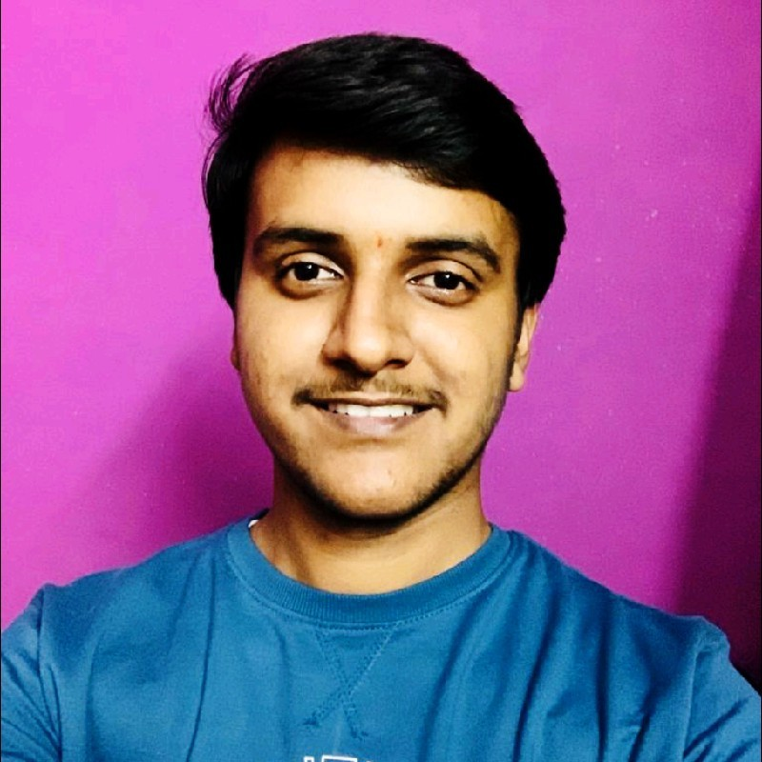


CREATORS DETAILS:
Shashank Paliwal:
SAP ID- 500095932
ROLL NO- R2142210945
BATCH- 6
Piklu De:
SAP ID- 500096448
ROLL NO- R2142211127
BATCH- 6
Shubham Jaiswal:
SAP ID- 500096554
ROLL NO- R2142211137
BATCH- 6

Slide 3

OVERVIEW:
In this Project, We are trying to build SAAS project which can be accessed via internet (Web Application) in which people or authors who are not recognized well yet in the society, and because of that they are not able to publish or sell their books in a huge numbers can place it in our website and we will help them to distribute their books over multiple regions. Along with books, novels a person can also put his thesis, research paper and views over the site.
It is basically a E-Commerce web application which only sells books in three formats -
Hard Copy
PDF’s(T&C)
Audio Books

Slide 4
ROLES:
Shashank Paliwal:
The Role in this Project was to gather the requirements for this project such as which platform to be used for the development of the project, what technology stack to be used in the project. The role was to create the SRS of the project, Use Case Diagram, DFD and doing a bit of help in the front end build up.
Piklu De:
The Major role was to create a good front end for this web application with the help of technology stack consists of HTML and CSS. It consists of creating a good login page, payment gateway page and a bit of help in building a mature backend.
Shubham Jaiswal:
The Major role was to create a mature Back end which has a better quality to organize the data received from the frontend. The Technology stack used in the building of the back end is Python. Other Role is to create the presentation for the project with voiceover included.
* It is a Prototype Model!!
* The DataBase is still in process.!!

Slide 5
What this Project will offer the Users?
This Project will offer the customers to purchase books of the unrecognized authors and will able to get the books at their respective destinations. This project gives a chance to aspiring authors to showcase their writing skills, without being worried about the distribution of book.
Moreover, they will be able to get the PDF and Audio format of the books with some T&C applied.
They have multiple facilities as same as the big e-commerce sites have viz Reviewing books in public only after purchase, replacement in case of damaged order.
The price distribution of the books in multiple formats will be different.
Customers can also review / rate the book.
Customer can also decide that his/her review should be seen by specific person, publicly, or by any community and with this feature we will achieve customization to some extent.
There will be some sort of subscription plans with which user will leverage some extra features of the site like, lifetime access of books, instant notification when a new book is added to the database.
With the help to recommendation system we can also recommend books to user (This can be done by analysing the reading history of user) .
The next slide will introduce how the project looks like when fully completed.
* It is just a prototype representation, not the original!

Slide 6
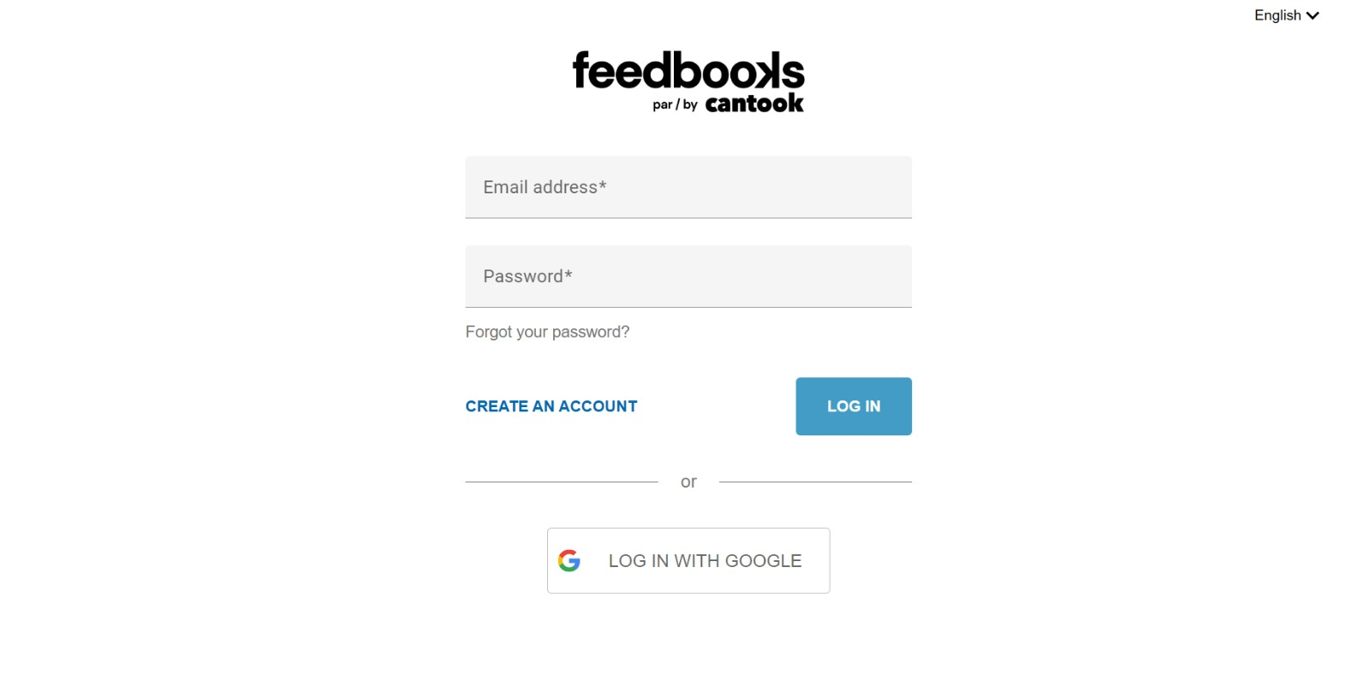

Slide 7
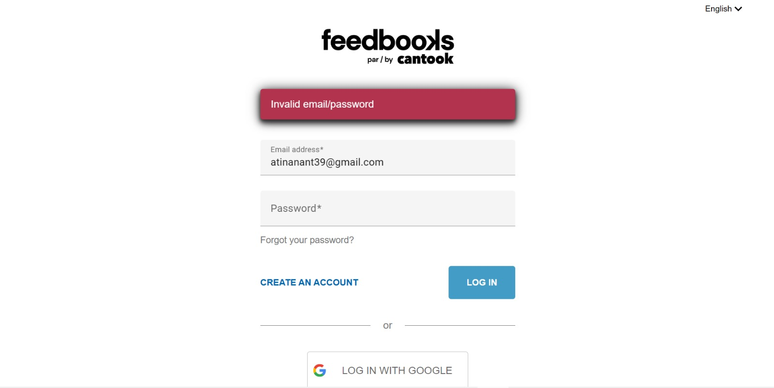

Slide 8
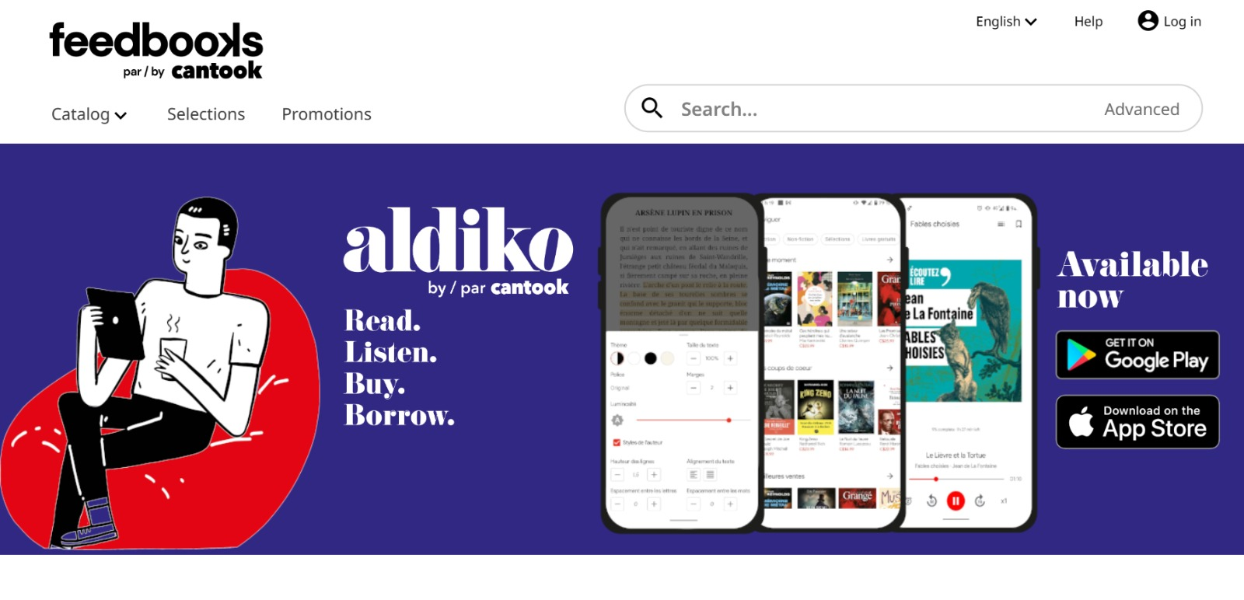

Slide 9
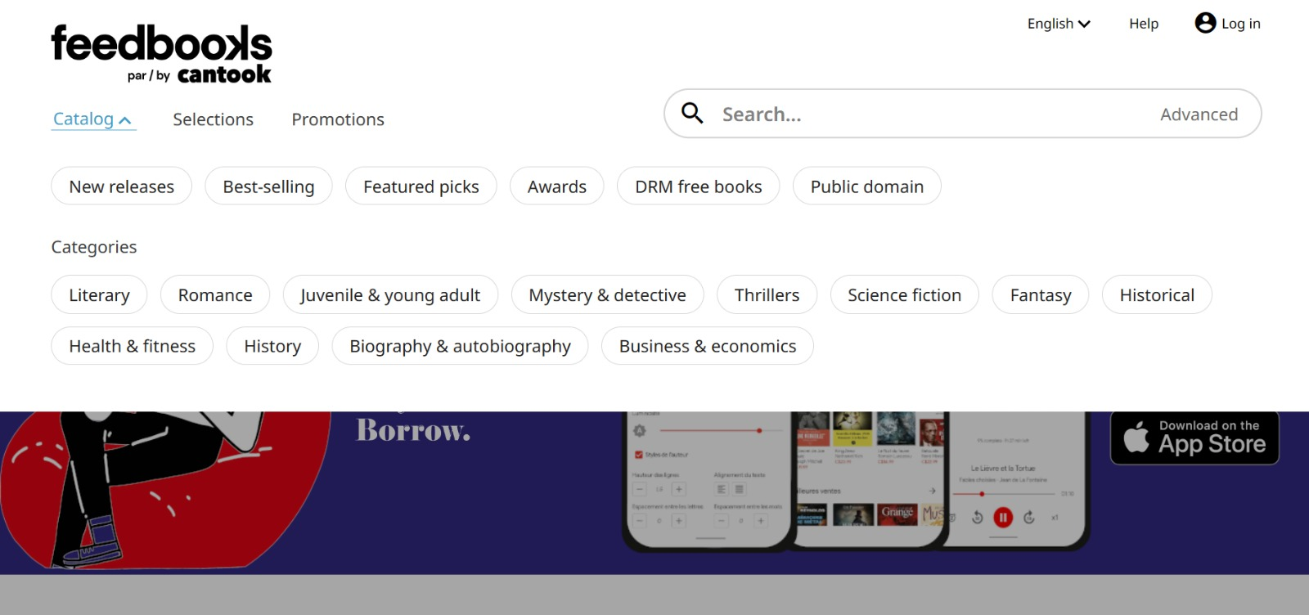

Slide 10
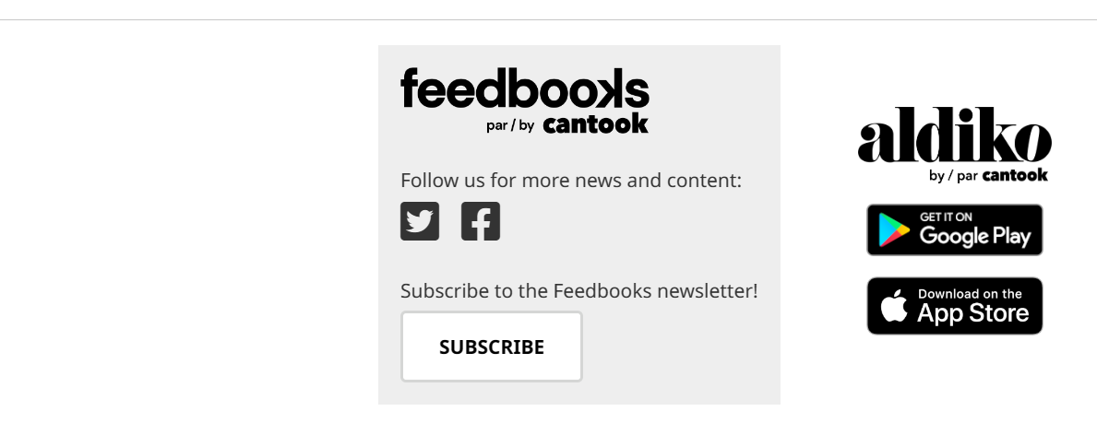

Slide 11
Thank YOU!

